Slide 1
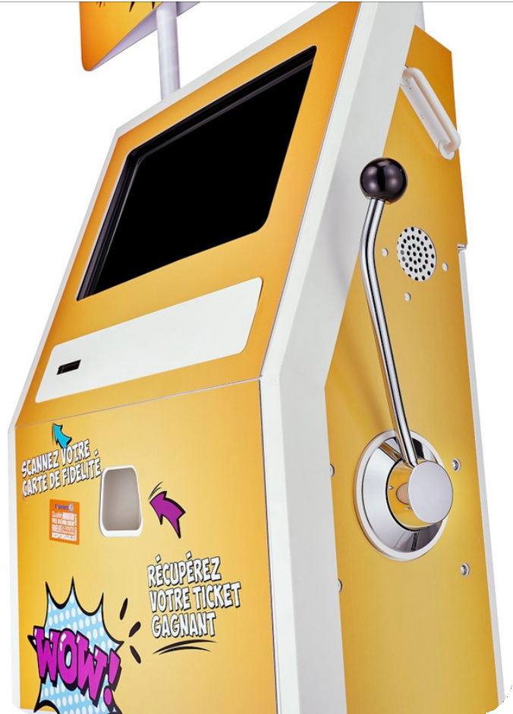
Why not “gamify” your marketing campaigns?

Slide 2



















































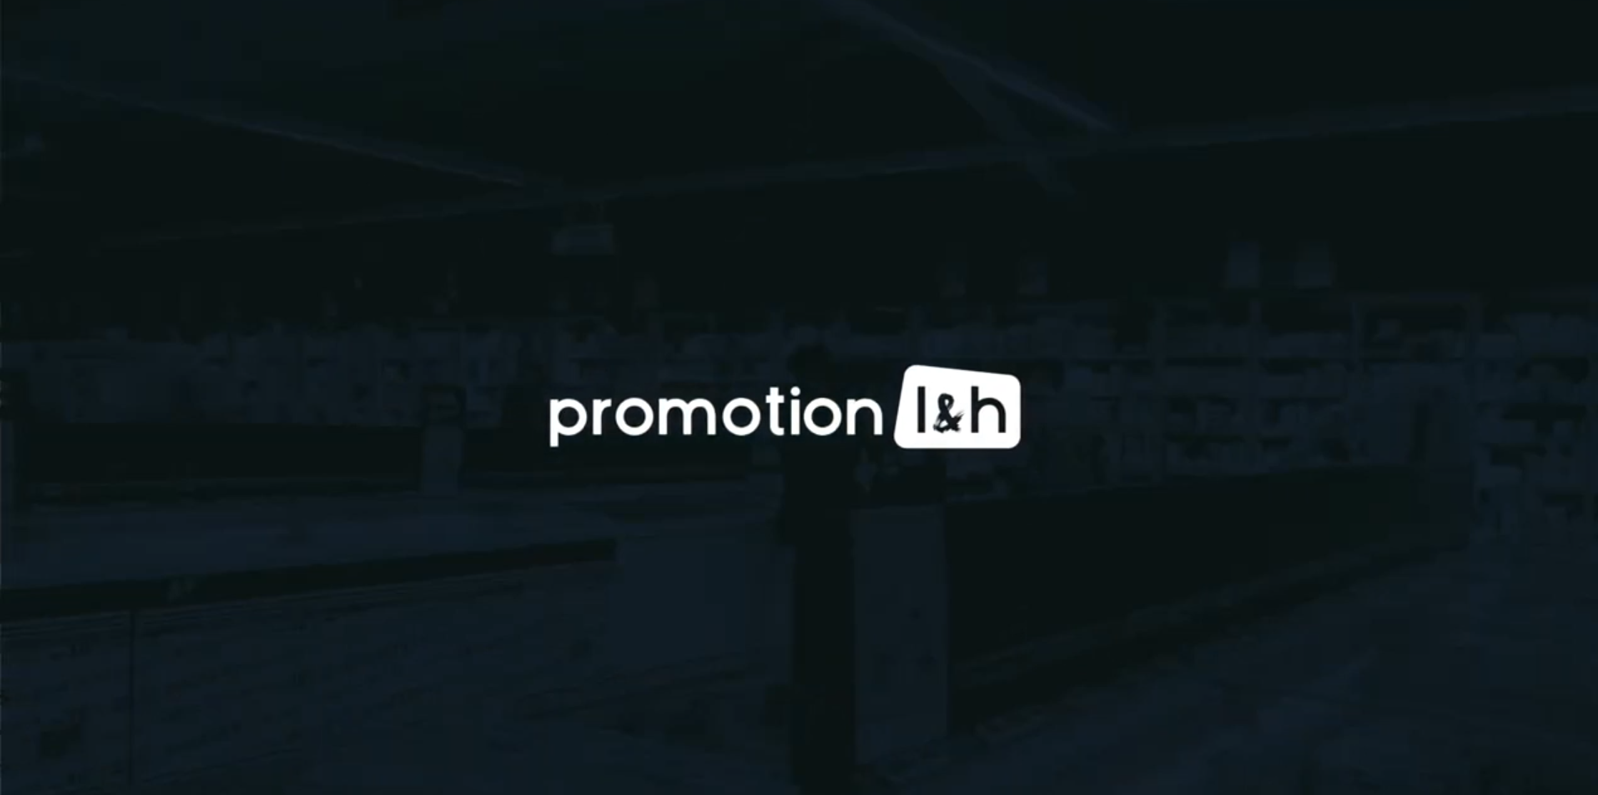



















Promotion L&H in a few words
Creation 1976
Head office in Lyon
20 employees
Specialist in "gamification” of the point of sale
Rental of game terminals and development of digital games
Turnkey solutions
Clients : Supermarkets, brands, shopping centres, etc.
4000 terminals
Activities in 60 countries

Slide 3
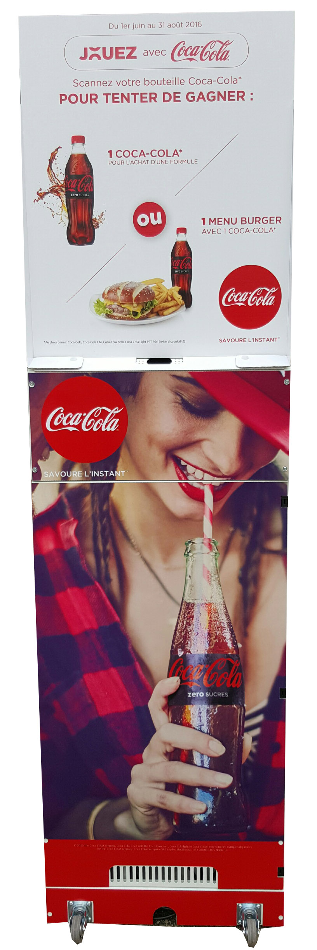
The gaming terminal for a brand: what for?
Launching a new product
Boosting sales of a product
Animating a promotional stand (tasting...)
Giving visibility to the brand on social networks
Running a trade marketing campaign

Slide 4
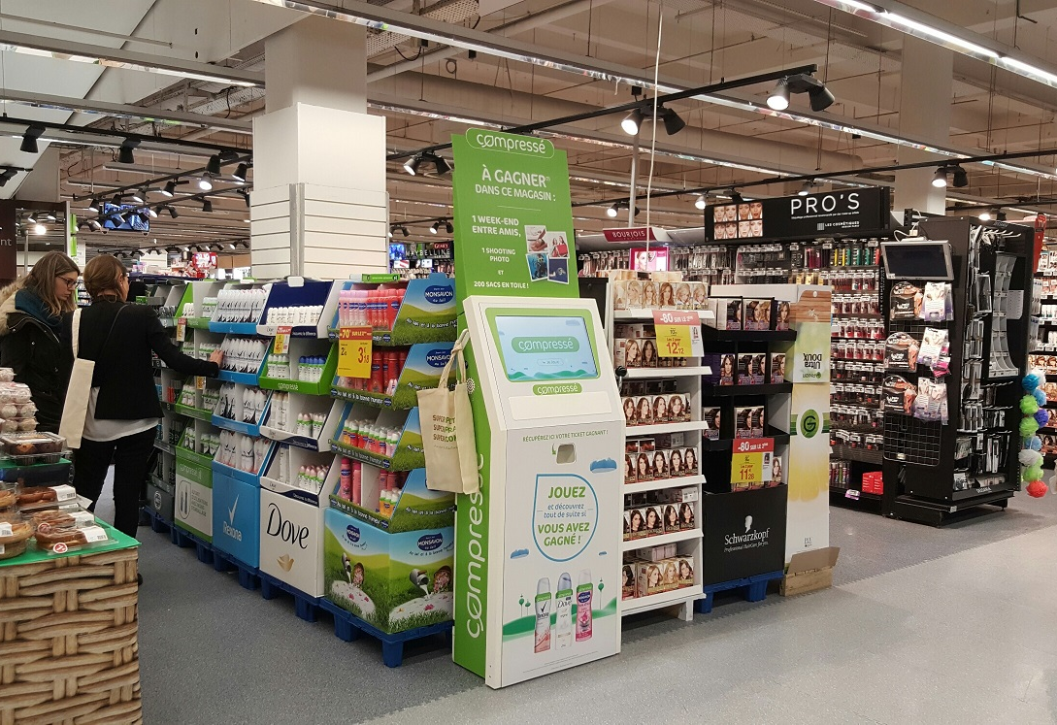
Example of mechanics for the launch of a new product: the UNILEVER case (France)
Context: New product "Déodorant compressé" promotion
Objective: to introduce this product by attracting hypermarket customers to the stand located near the beauty section
Device: 10 game terminals installed in 10 hypermarkets in France. A hostess near the terminal guides customers.
Mechanics: to be allowed to play, the consumer must enter his details on the terminal. He knows immediately if he has won a prize.
Logistics in charge of Promotion L&H

Slide 5
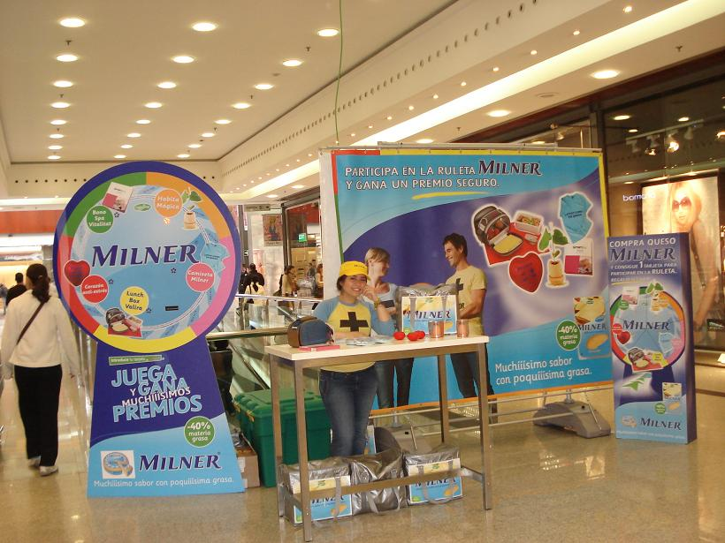
Example of a mechanism to boost brand sales: the MILNER case (Spain)
Objective: to boost the referencing of MILNER products in supermarkets in the Barcelona area
Device: roadshow in all the shopping centres in the Barcelona area with 5 terminals. A total of 30 events over 2 days (Friday and Saturday)
Mechanics: a tasting stand is present in the supermarket of the gallery. If the consumer has bought MILNER products in the supermarket, he/she can play at the kiosk located in the gallery. A hostess checks his purchases against his receipt before playing. The consumer can immediately win discount vouchers to be used on future purchases of MILNER products in the supermarket.
Logistics in charge of the Spanish agency
Results : referencing +400%.

Slide 6
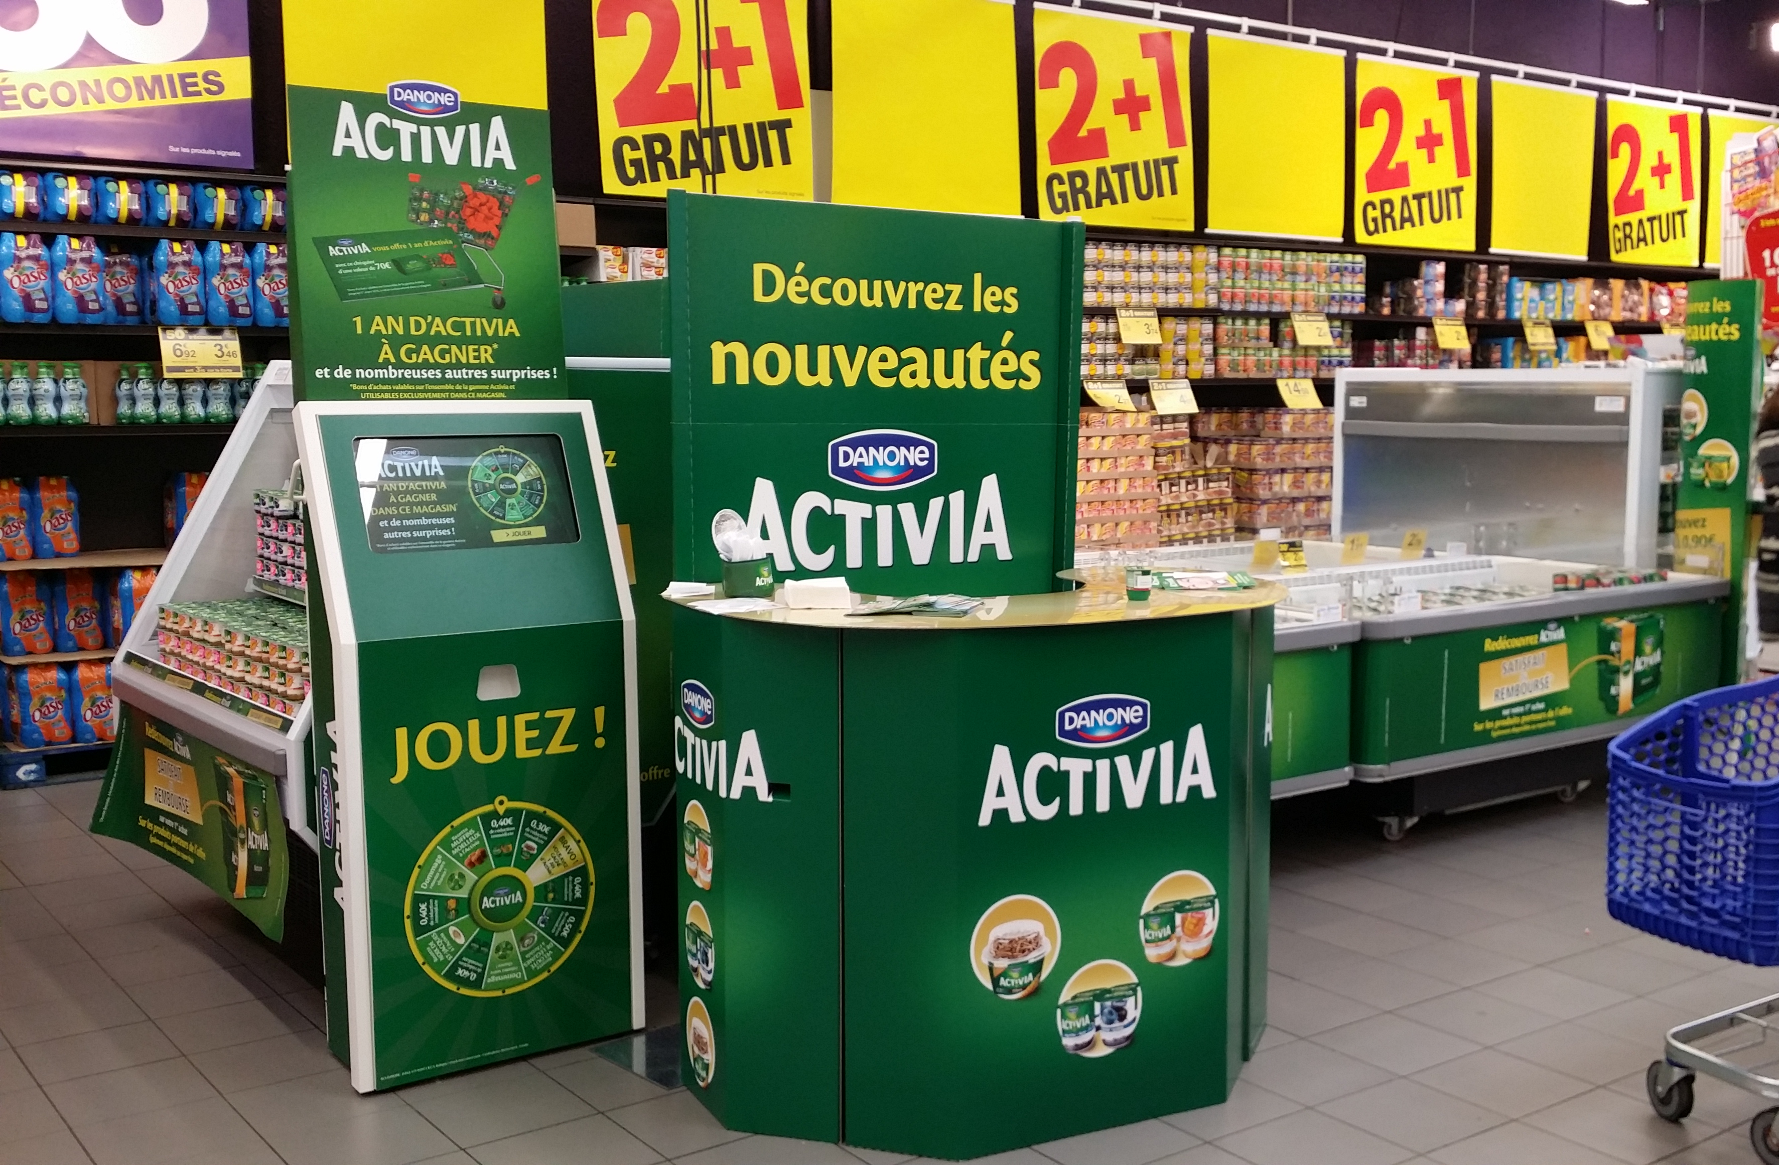

Example of mechanics for the launch of a new range: the DANONE case (France)
Objective: to launch the new range of yoghurts under the ACTIVIA brand (DANONE)
Device: 10 mobile terminals visit about 50 hypermarkets in France. A tasting stand of ACTIVIA products near the kiosk and a hostess to animate the kiosk and the stand.
Mechanics: all customers who pass by the stand can play at the terminal and find out if they have won instantly (wheel of luck animation).
Prizes to be won: discount vouchers on ACTIVIA products, 1 year of ACTIVIA (limited to €70).

Slide 7
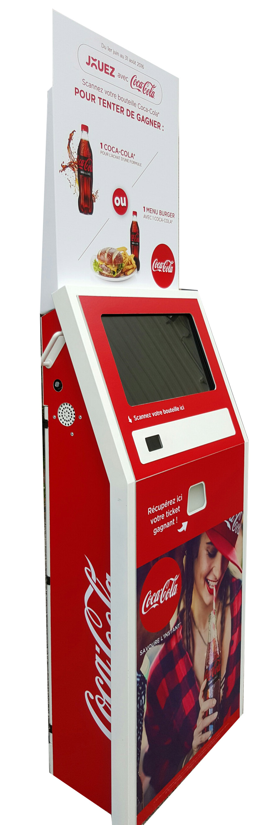
Example of a trade marketing mechanism: the COCA-COLA case (France)
Objective: to boost COCA-COLA sales in hypermarkets and burgers sales in the fast-food outlet in the shopping mall
Device: 20 terminals in several hypermarkets in France
Mechanics: after passing through the checkout, the consumer scans the barcode of the COCA-COLA bottle they have purchased in the shop. His winnings are revealed instantly.
In the fast-food outlet, they win 1 free bottle of COCA-COLA if they buy a full menu, or a free burger if they buy a bottle of COCA-COLA.

Slide 8

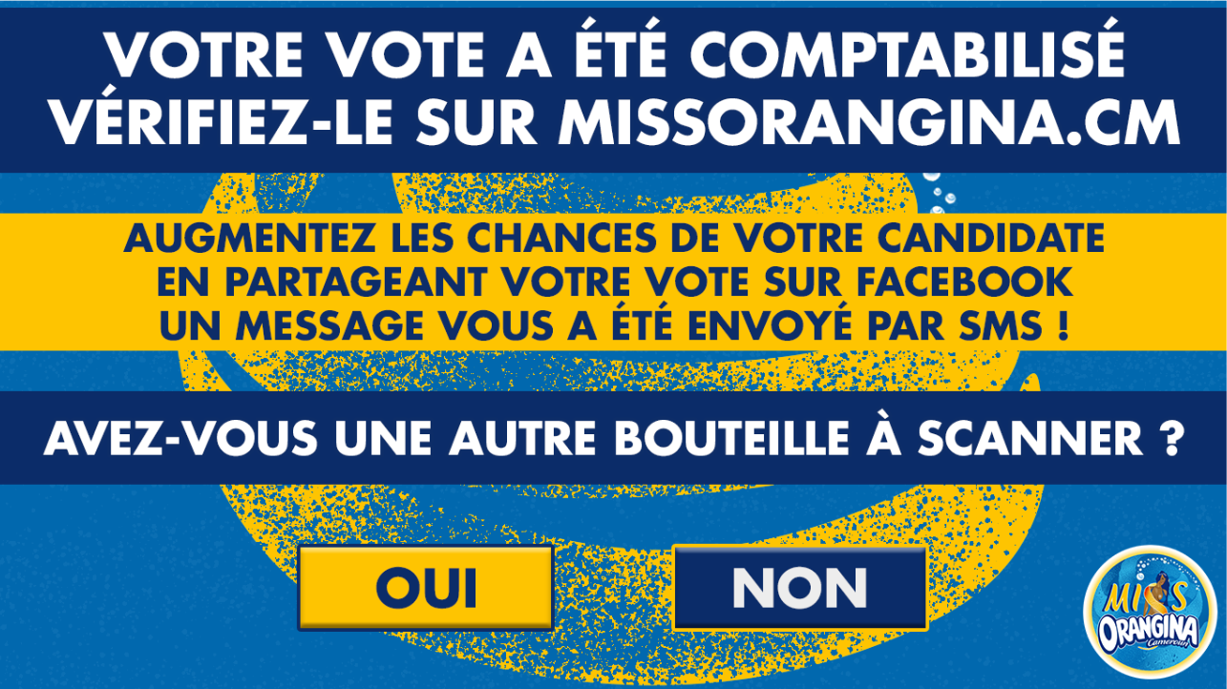
Example of a mechanism to boost sales and brand awareness: the ORANGINA case (Cameroon)
Context: Miss Orangina Cameroon 2020 election
Objective: to boost sales and brand awareness
Device: 4 terminals installed in 4 supermarkets in Cameroon
Mechanics: to access the game, the customer has to scan his receipt and the barcode present on the bottle of Orangina bought in the shop on the terminal. They must then fill in a form before voting for the miss of their choice and obtain a discount voucher to be used at the checkout (100% winner). They then receive a confirmation message of their vote by text message which they can share on Facebook to create a buzz.

Slide 9
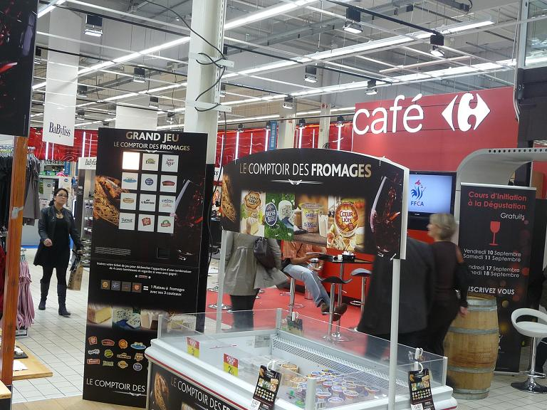
Example of a mechanism to increase brand awareness: the BONGRAIN case (France)
Objective: to promote the brands of the company SAVENCIA FROMAGE & DAIRY (formerly BONGRAIN)
Device: 2 terminals installed in 2 hypermarkets near a cheese tasting stand of the group's different brands. A hostess near the kiosk guides the customers.
Mechanics: the hostess distributes game coupons to customers passing in the central path of the hypermarket. The customer inserts the coupon in the terminal and finds out instantly if he or she has won a discount coupon on one of the partner brands' products.

Slide 10
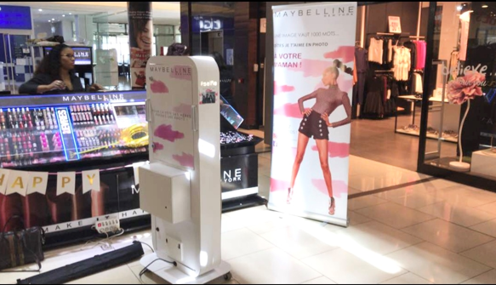

Example of a mechanism to increase brand awareness on social networks: the L'OREAL case (Senegal)
Objectives:
  To create engagement and proximity between Maybelline NY Afrique and its customers
  To position Maybelline NY Afrique as a major digital player in Africa
  To boost and animate Maybelline NY Afrique's social networks
Device: 1 selfie terminal installed in the L'OREAL boutique located in the gallery of the largest shopping center in Dakar, Sea Plazza.
Mechanism: customers, mother and daughter, are invited to go to the Sea Plazza boutique via social networks to take the most beautiful "mother-daughter" photo. Once the photo has been taken on the selfie machine, it must be published on social networks directly from the selfie machine. The winners are chosen by a jury from L'OREAL.

Slide 11
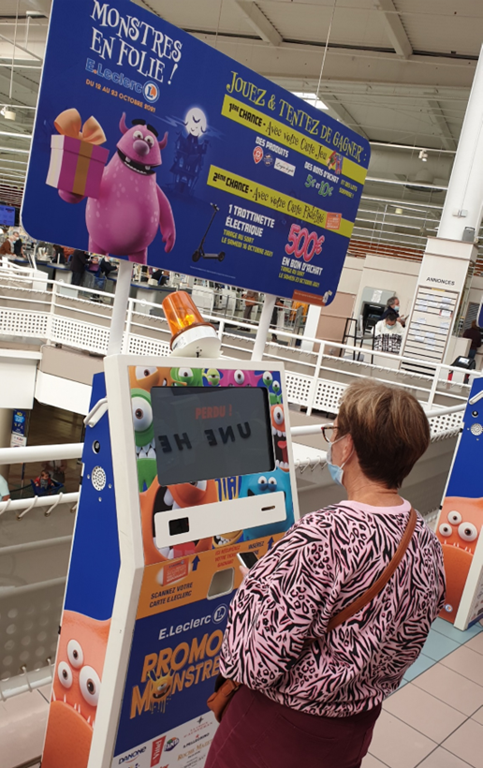
E.LECLERC SCACHAP : Monsters on the Run Birthday! (3.5 million players in 5 weeks)
The 660 French shops of the E.Leclerc movement are grouped into 16 purchasing centrals. Almost all the E.Leclerc purchasing centrals have celebrated their birthday with game terminals at one time or another. SCACHAP, which groups 38 shops, is a good example. It has been using game terminals every year for more than 10 years to animate its regional anniversary operation.
SCACHAP has often changed its terminal models over the years, in line with the innovations proposed by Promotion L&H: the cardboard terminals with LEDs gave way to square terminals with triple entry, then to cardboard terminals with screens, and finally to digital terminals. Customers are fans of the digital terminal, because of its look, its joystick and its jackpot animation. The shop staff also appreciates the ease of use of this terminal.
The central does not hesitate to vary the game mechanics: distribution of game cards at the cash desk, or tokens personalized with the colors of the partner brands, game with a receipt or with a loyalty card, game with or without a final draw...
But above all, the company makes sure that the mechanics are always simple to understand by the customers, because it knows from experience that the simplicity of the game is an essential condition for the success of a large-scale operation

Slide 12
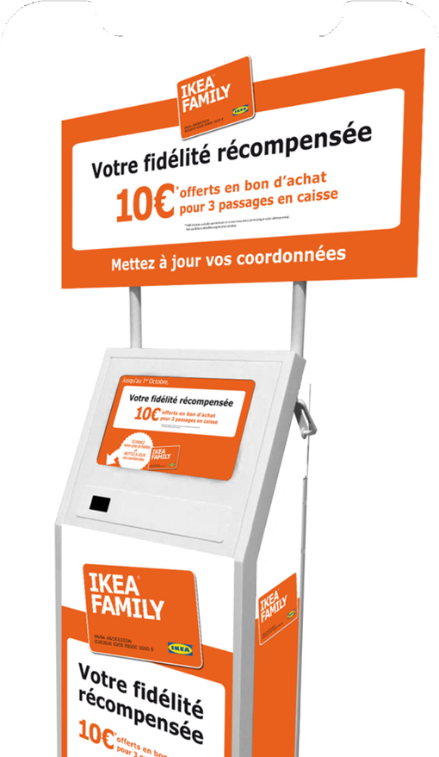
IKEA: loyalty rewarded (2287 contacts collected during 1 month)
IKEA has more than 430 shops in nearly 50 countries, including 34 in France. The IKEA shop in Toulouse is one of the largest in France, both in size and turnover. At the entrance of each shop, two PCs are installed for customers to sign up for the IKEA FAMILY loyalty program, but they are not used much because they are not visible enough.
The management of the IKEA shop in Toulouse wishes to accelerate the registration of its customers. They want to install a more dynamic system with a better return in terms of data collection.
It was therefore decided to temporarily install 2 digital game terminals at the entrance to the shop, which are highly visible to customers as they enter the sales area. For each completed form, the customer is entitled to a €10 discount on their next in-store purchase (subject to a minimum purchase of €100).

Slide 13
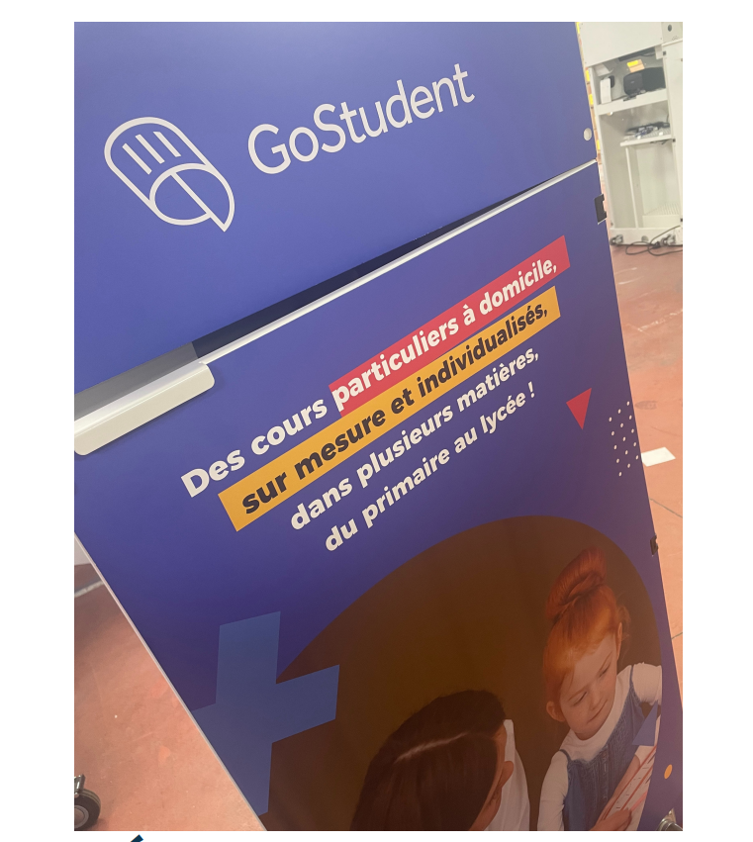
Go student : the fun and educational terminal!
The event awaited by all students every year is of course the student fair. So, let's go to Eurexpo in Lyon, from March 19th to 20th. To start this year 2022, Go Student, leader in home schooling support since 2016, decided to surround itself with our teams. This operation is as much a challenge for us as for our partner. Reconquest! This is the key word for this coming year. On the program, we will be hosting a stand and creating a tailor-made event through a terminal that promises to be a great cerebral gymnastics session!
Our digital terminal with a 100% customized design contains a quiz for this event. Thanks to its 42" touch screen, the game becomes simple and attractive. This quiz is an instant win, 100% winning! Private lessons and trial lessons are at stake.
Via the terminal interface, students and their families will be able to choose between 3 subjects: English, French and Math. 5 questions will be asked. If you have the right answer, a win screen will appear. If you don't have the right answer, a correct answer screen will reveal the correct answer to the question. Whatever the result is, you've got it, it's a win. At the end of the quiz, a form to be filled in allows Go Student to collect data.
About a hundred people tried their luck at our game. In conclusion, this commercial event enabled our client Go student to attract students by creating a unique event that left a mark on people's minds and brains!

Slide 14
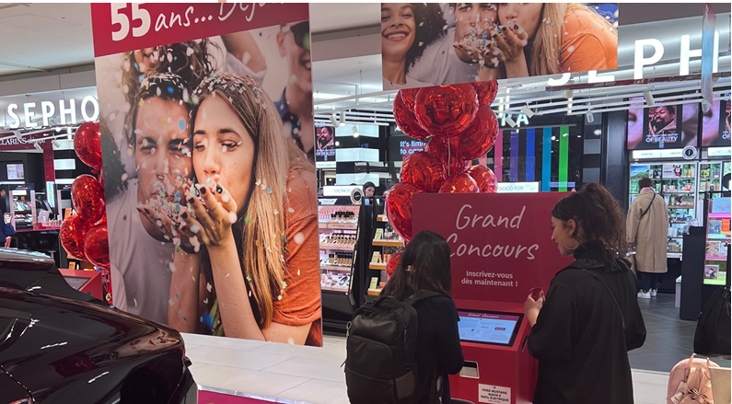
The "chance" terminal on Swiss time!
Marketing objectives : We headed to Switzerland, to Geneva for the following project.
Our partner Manor deploys an operation from March 17th to 26th in a 4-storey shopping center.
At the beginning of this year, Manor is celebrating its 55th anniversary, and to mark the occasion, there is a game to be played and some very special prizes to be won.
Devices and prizes : 3 digital terminals and 2 totem data terminals will be deployed in the center to cover the entire surface of the center and to facilitate customer traffic.
Our digital terminal will be personalized with a special design and will contribute to the animation of the center.
The totem terminal was also part of the event. The digital terminal made it possible to program an "instant win" game and the totem terminal was dedicated to the draw.
Two game mechanics are proposed: the first, via the digital terminal and thanks to the progressive bar code to be scanned, which triggers a jackpot game in instant win. The second, via the totem terminal and thanks to a form to be completed, allows customers to participate in a draw. And as there are two types of terminals, two customer paths are possible!
For the "chance" terminal, nothing could be simpler: customer reception, scan of the game card, jackpot game and issue of the winning ticket. The card allows the customer to play once a day.

Slide 15
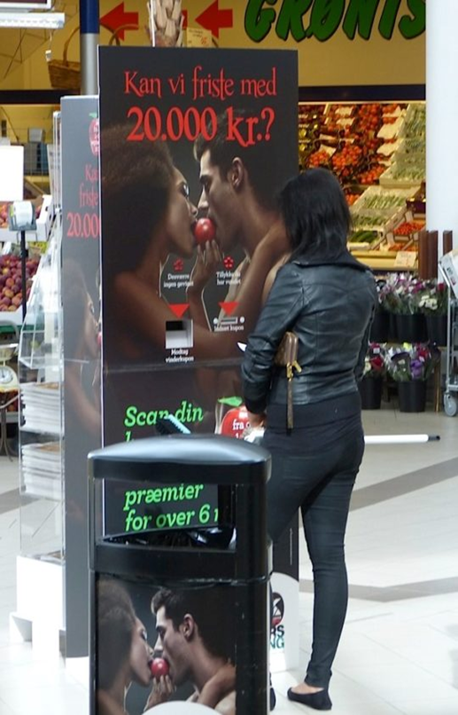
Kolding Storcenter Denmark : The Danes also love gaming terminals!
KOLDING STORCENTER is one of Denmark's largest shopping center, located in the city of Kolding. It has 120 shops and restaurants and has been voted Denmark's best shopping center several times.
The shopping center's communication agency asked us to animate the shopping center on its anniversary. Eight cardboard game terminals with LEDs were installed at strategic locations in the mall. The shops that agreed to participate in the operation put their own prizes into play. The game cards are distributed at the checkouts of all partner shops. Customers go to the gaming terminal, insert their gaming card and can win prizes instantly. In order to get their prize, the winners must go to the shop indicated on the ticket printed by the terminal.

Slide 16
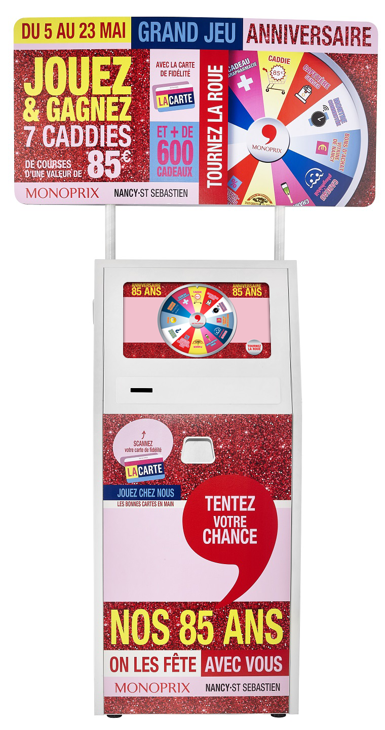
How does the game terminal work?
Game mechanics :
Game card
Token
Loyalty card
Cash register ticket
Bar code
QR-code
Tactile
1- Inserting the game card
2 - Gain revelation
3 - Printing of winning tickets

Slide 17
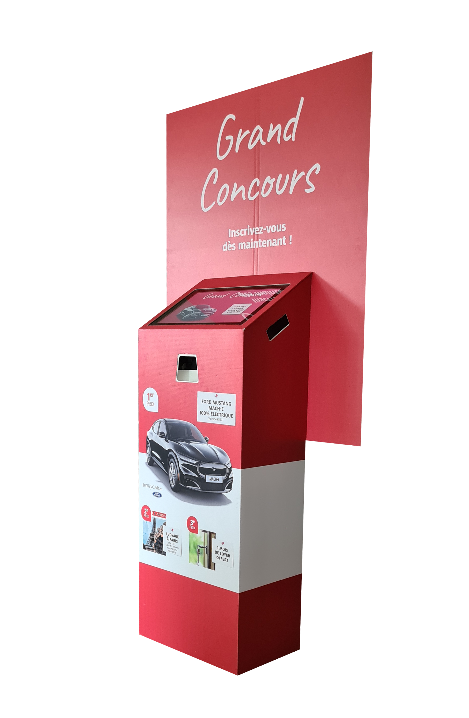
Our gaming terminals have been specially designed for branded operations. Why are we doing this?
No assembly or disassembly
Easy to move thanks to its low weight, handles and wheels
4G connection for real time processing
Remote monitoring of the terminal by sending anomaly messages to our supervision centre
Almost infinite possibilities of game mechanics and customer paths
Game statistics available in real time thanks to the LHSTATISTICS app
Real-time data feedback from the terminal

Slide 18
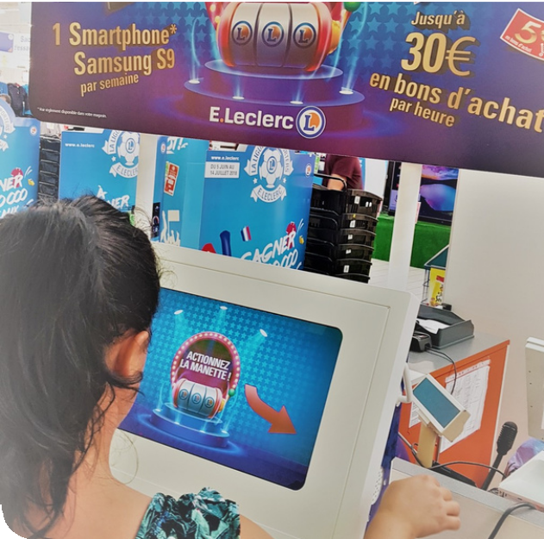
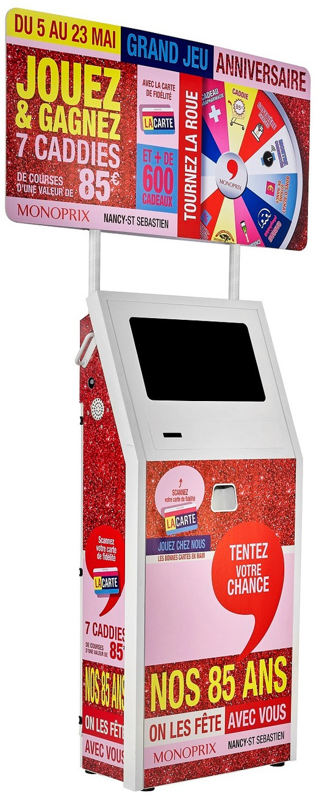
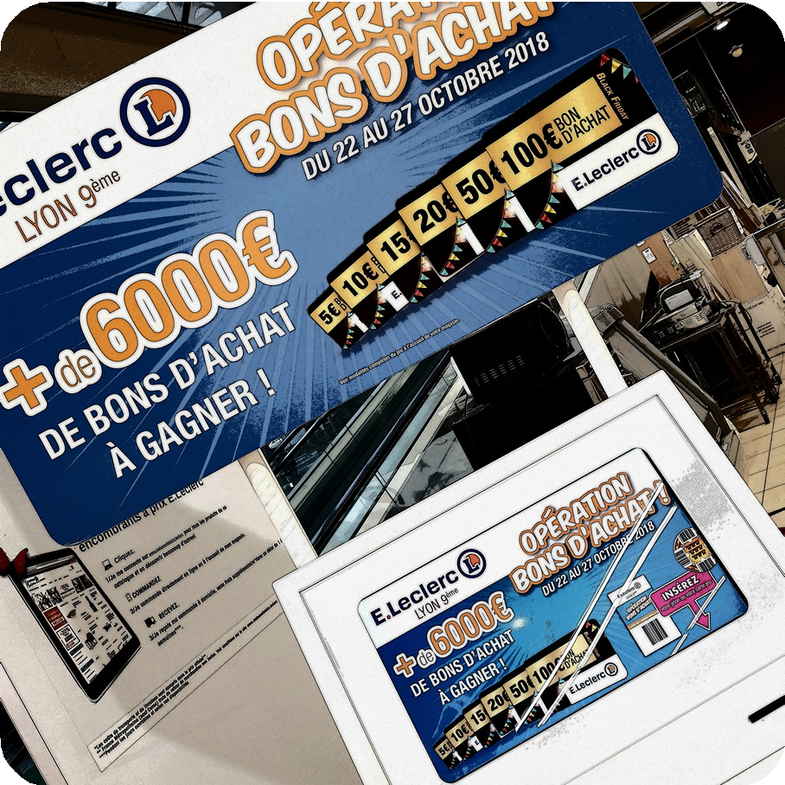
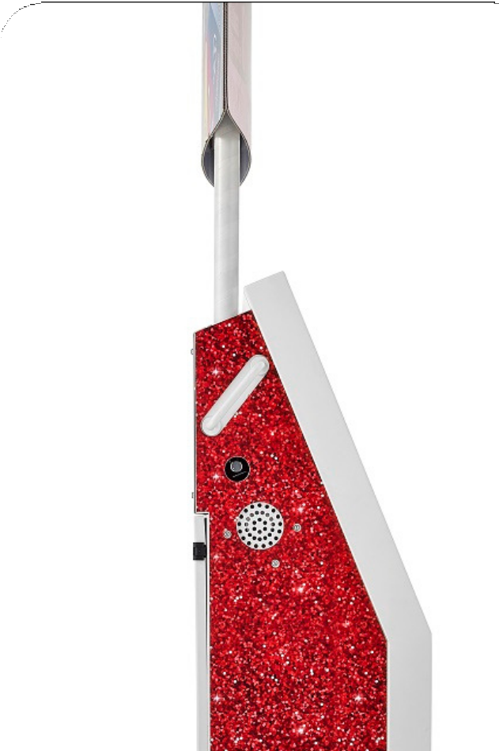
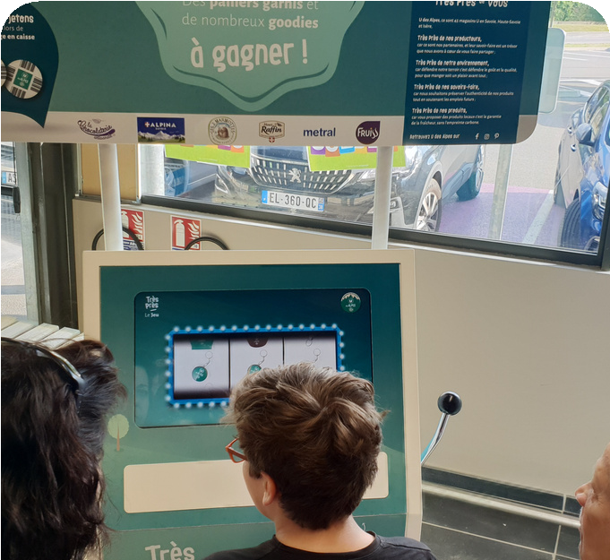
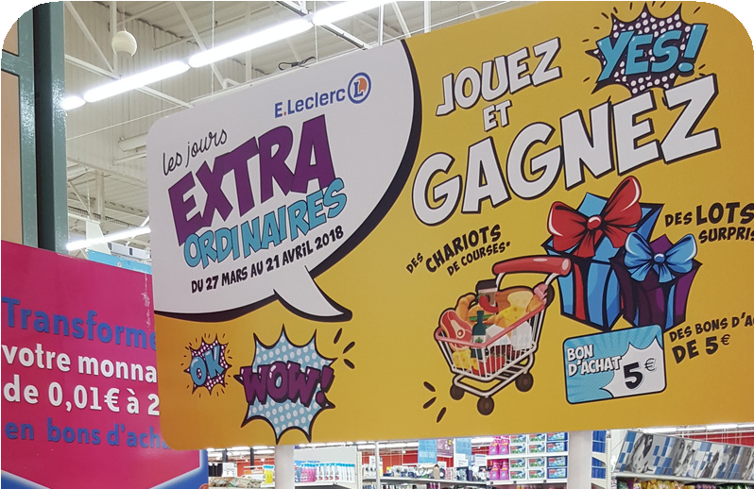
The digital gaming terminal

Slide 19
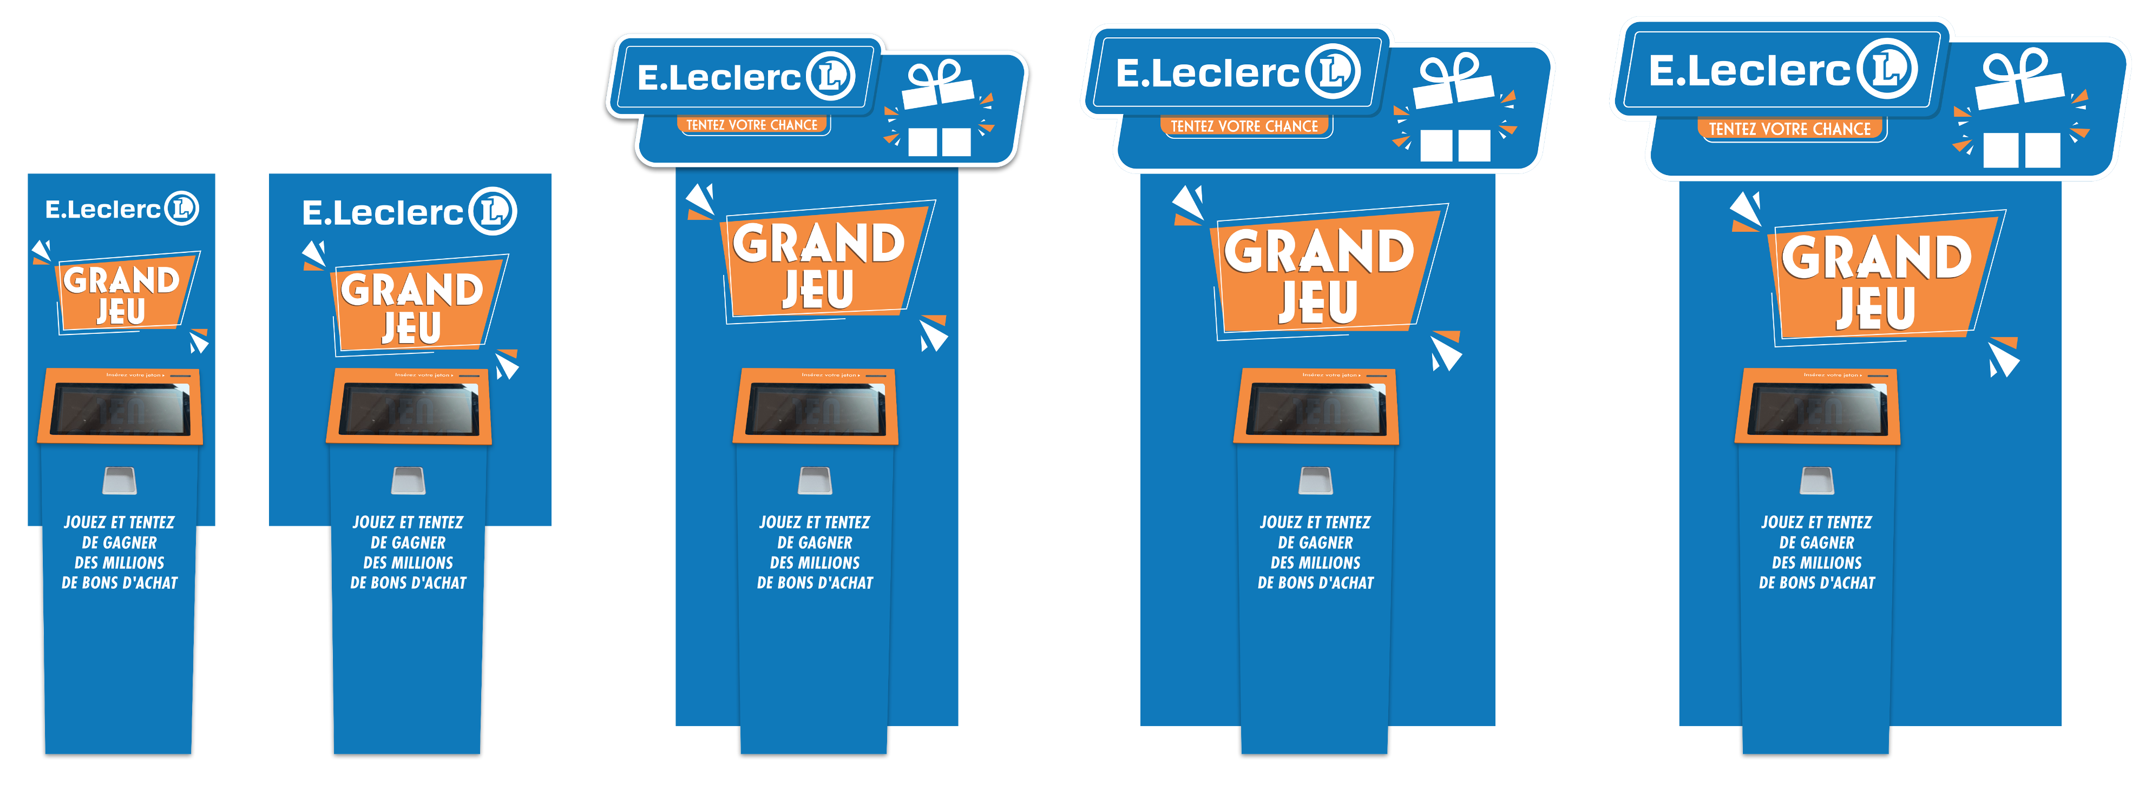
The totem terminal

Slide 20
The totem terminal
Pupitre en aluminium - H 1100 x L 424 x P 300 mm
Habillage pupitre carton imprimé quadri face avant et côtés
Facing arrière imprimé quadri recto verso H2000 x L1000mm
Animation écran tactile 15''
Scanner ou cellule infra-rouge
Toutes mécaniques de jeu
Son personnalisable
Impression ticket gagnant
Connexion mobile pour remontée données temps réel
Poignées et roulettes pour les déplacements
Installation très facile, facing arrière à clipser sur pupitre
Livrée en caisse-palette
L 1182 x h 412 x l 525 mm – poids borne emballée 25 kg
-Gaming terminal consisting of an aluminum desk and a cardboard back panel and optional cardboard front panel
-Desk H 110 x W 424 x D 300 mm - Full color print on all sides
-15.6" PCAP touch screen
-2 scanners for reading tokens, game cards, loyalty cards, barcode tickets, etc.
Rear facing in four-color printed cardboard - H 2000 mm without pediment / H 2200 mm with pediment -3 widths W 800 / W 1000 / W 1500 mm
-Speaker
-Thermal printer to print winning tickets
-Mobile / WIFI / RJ45 connection
-2 castors and handles
-Delivered in a cardboard fly case W 1182 x H 412 x D 525 mm - weight approx. 25 kg

Slide 21
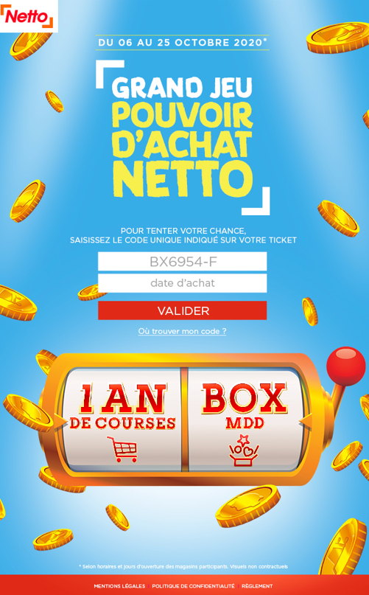
Digital games
Web game
Mobile game
Digital game coupled with a gaming terminal
Prize per shop
Prize sent by email
Unique winning QR-code
App to check the winning QR-code
Large selection of reveal games
Prize draw
Real time statistics

Slide 22
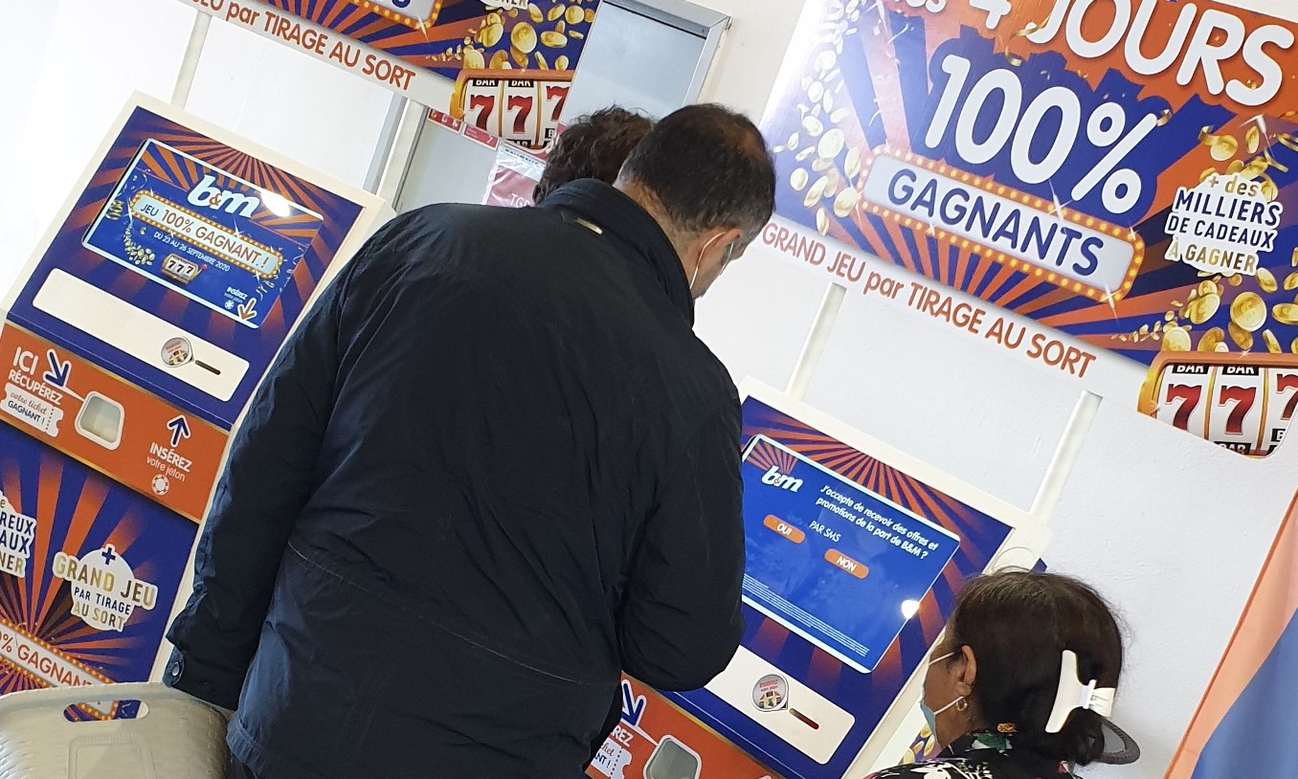
Our services
Gaming terminal rental
Digital game creation
Push sms
Emailing
Hostesses and animators
Sourcing of prizes
Management of prizes
Game rules
Graphic design
Scorecards
Delivery and collection
24-hour hotline
On-site maintenance
Turnkey operation

Slide 23
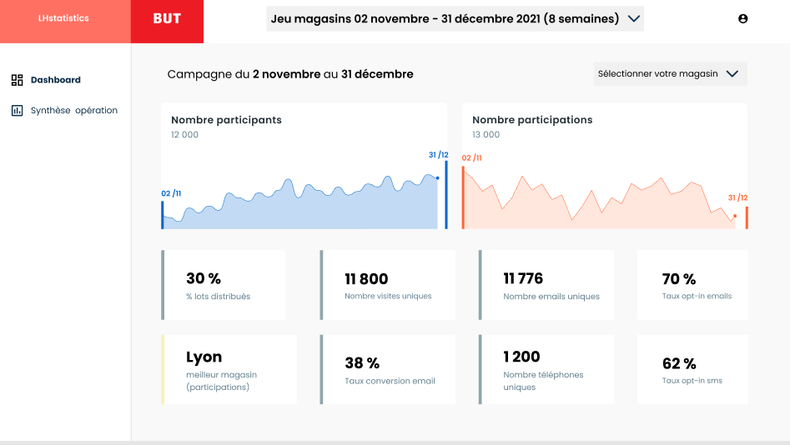
KPI / statistical monitoring
On mobile and desktop app
Customized indicators
Real time

Slide 24
La borne totem
- pour les opérations locales et régionales
- pour les marques

